Slide 1




Uncertainties and errors when using GBIF data
Slides CC-BY Dag Endresen, GBIF.no
Notes:
Slides CC-BY Dag Endresen, GBIF Norway, UiO Natural History Museum, University of Oslo – last updated 2018-02-14
Image source:
http://www.istockphoto.com/photos/square+peg+in+a+round+hole?facets={%22text%22:[%22square%20peg%20in%20a%20round%20hole%22],%22pageNumber%22:1,%22perPage%22:100,%22abstractType%22:[%22photos%22],%22order%22:%22bestMatch%22,%22f%22:true}
https://www.flickr.com/photos/epublicist/3546059144 CC-BY Yoel Ben-Avraham

Slide 2
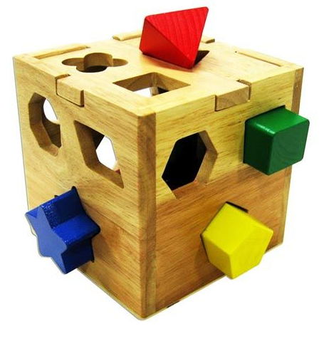
Fitness for use Definition
Data quality is a concept relative to the intended data usage...
"The general intent of describing the quality of a particular dataset or record is to describe the fitness of that dataset or record for a particular use that one may have in mind for the data."
Chrisman, 1991
Slide by Laura Russell, VertNet, September 2011
Notes:
Here, we finally define clearly what we call fitness for use, based on prerequisites we just did.
=> We cannot really discuss quality of data without knowing its usage...
In a database, the data has no actual quality or value. But they have potential value that is realized only when we use them.

Slide 3



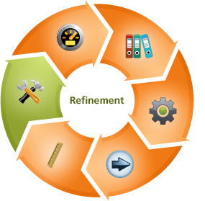
GBIF & data quality
GBIF provides services and tools
to identify data quality issues and
solutions for improving the usefulness
and fitness for use of biodiversity datasets.
Taxonomic interpretations and standardization
Geographic validation and enrichment
Temporal dimension and validation
Dataset descriptions, methodology & provenance
Notes:
GBIF provides a services and tools
to identify data quality issues and
solutions for improving the usefulness
and fitness for use of biodiversity datasets.
Taxonomic interpretations and standardization
Geographic validation and enrichment
Temporal dimension and validation
Dataset descriptions, methodology & provenance

Slide 4
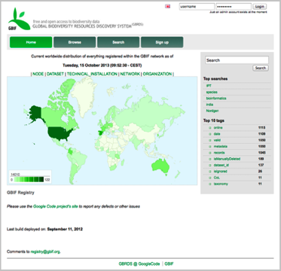
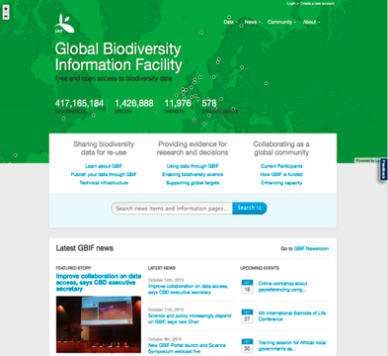
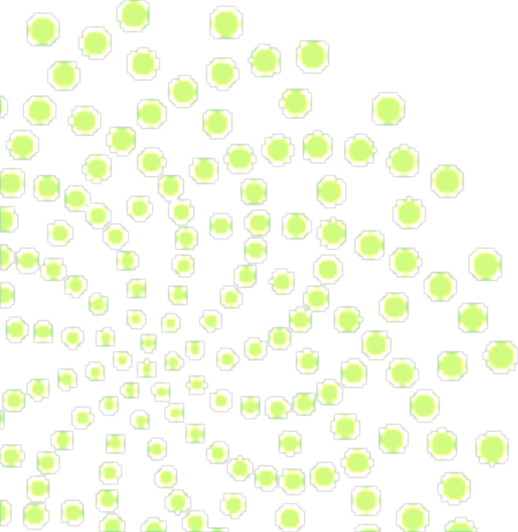
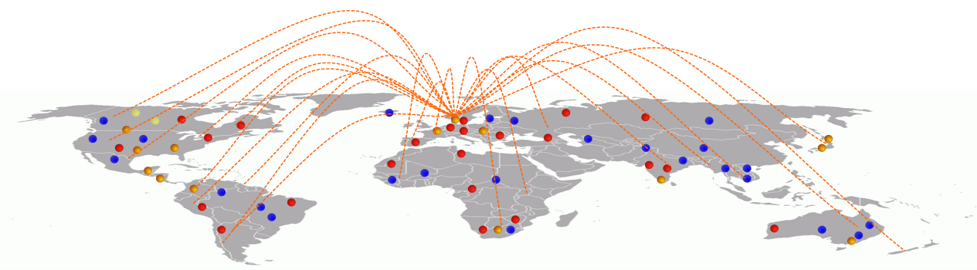
GBIF provides a data discovery system
that is dependent on resolvable stable identifiers for efficient functionality
global registry
data portal
Notes:
GBIF is dependent on resolvable and stable identifiers for efficient functionality. Identifiers for occurrences and for datasets etc.

Slide 5
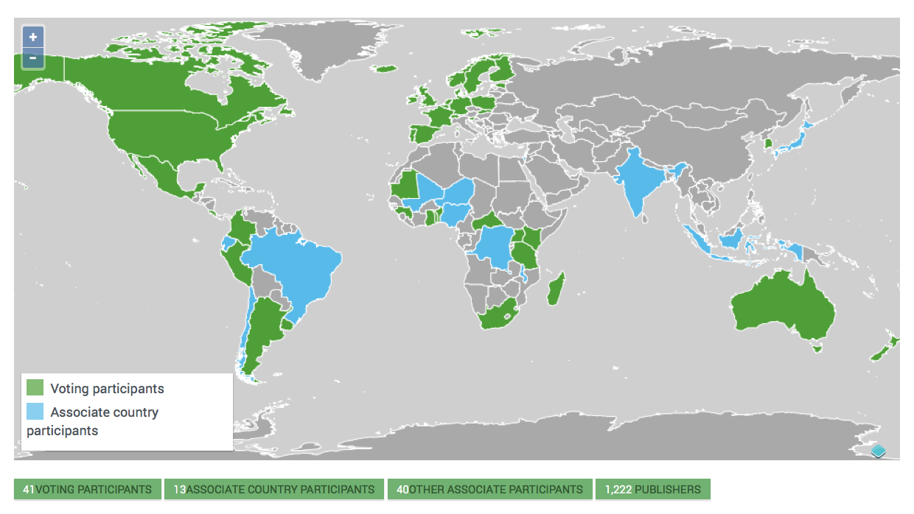

Biased representation in country membership
NB! The low membership coverage in Asia and Africa is an important geographic gap!

Slide 6
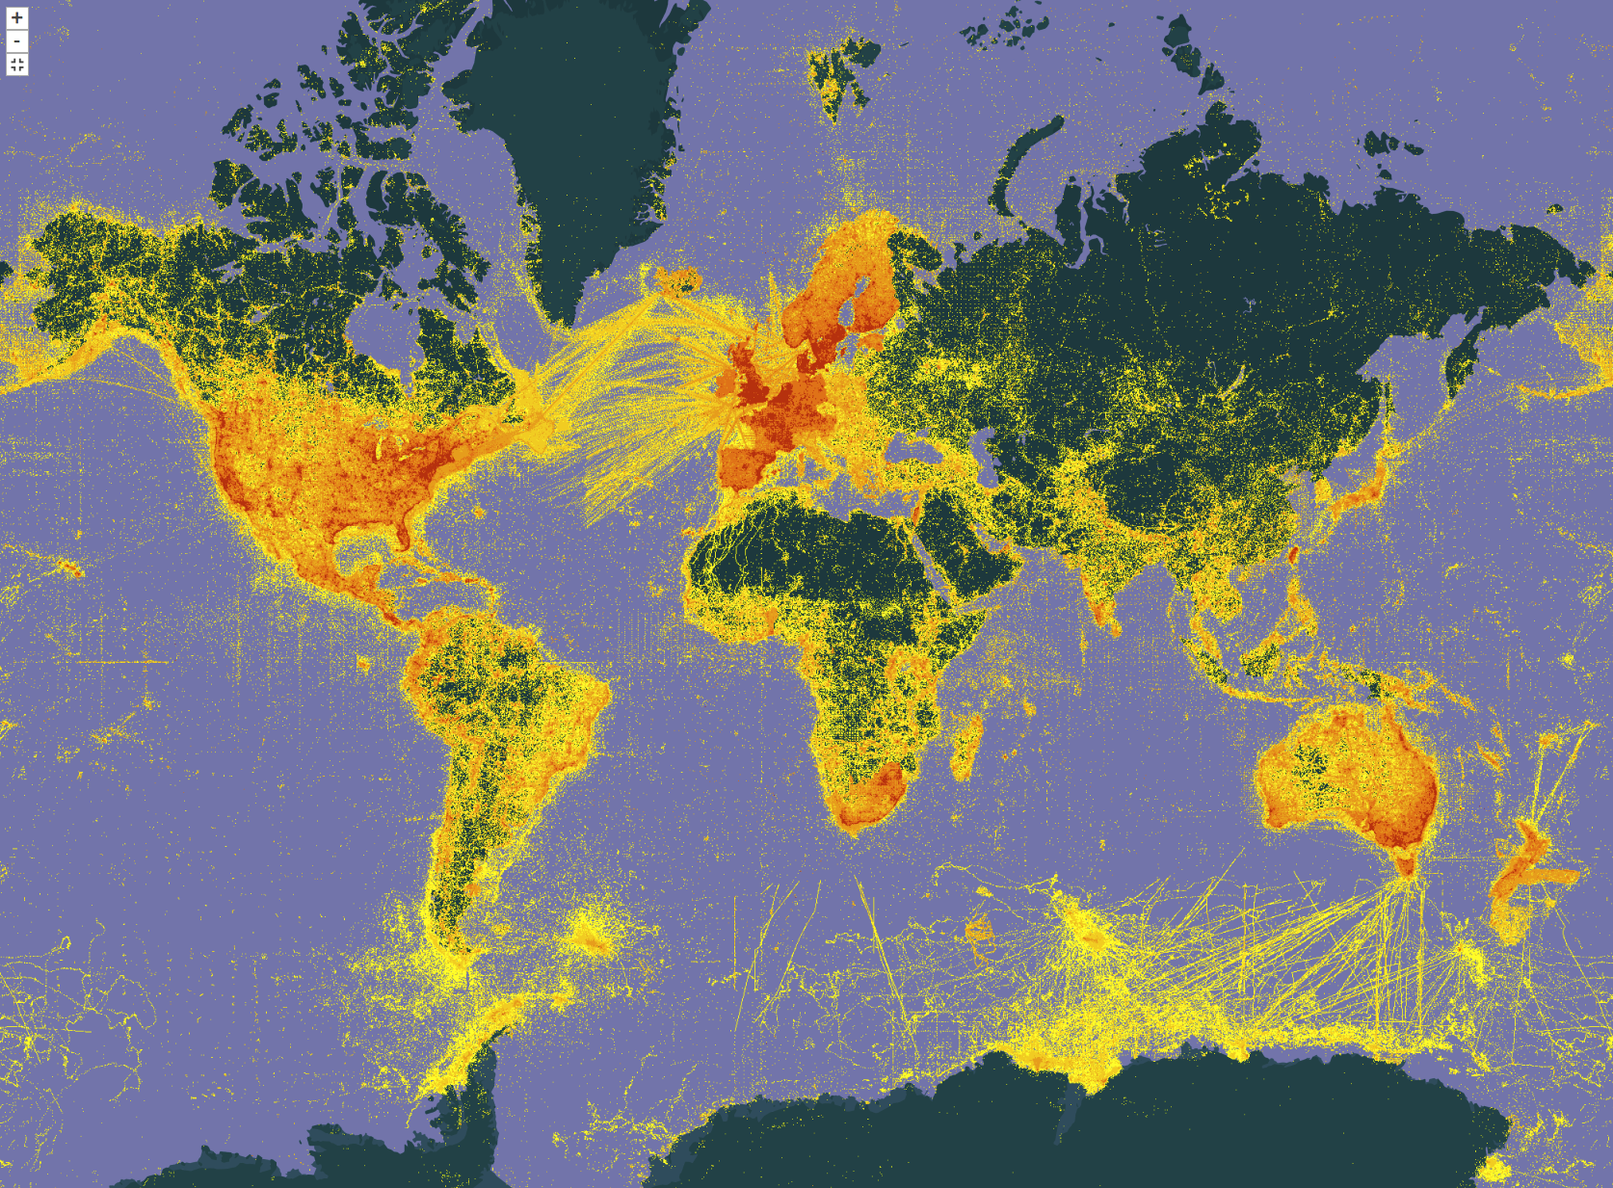
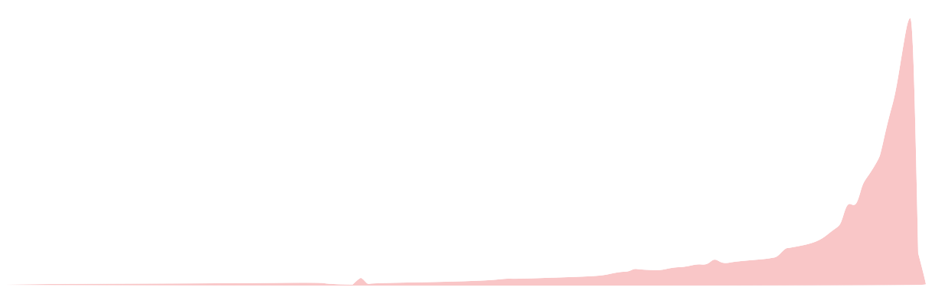
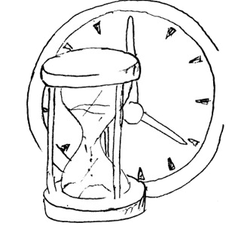
Data coverage and gaps
Biased sampling in space and time
Map updated 8th November 2017
Asia (gap in data coverage)
Africa (gap in data)
Most data are from
more recent dates
1900
1950
2017
Notes:
Map updated 8th November 2017

Slide 7
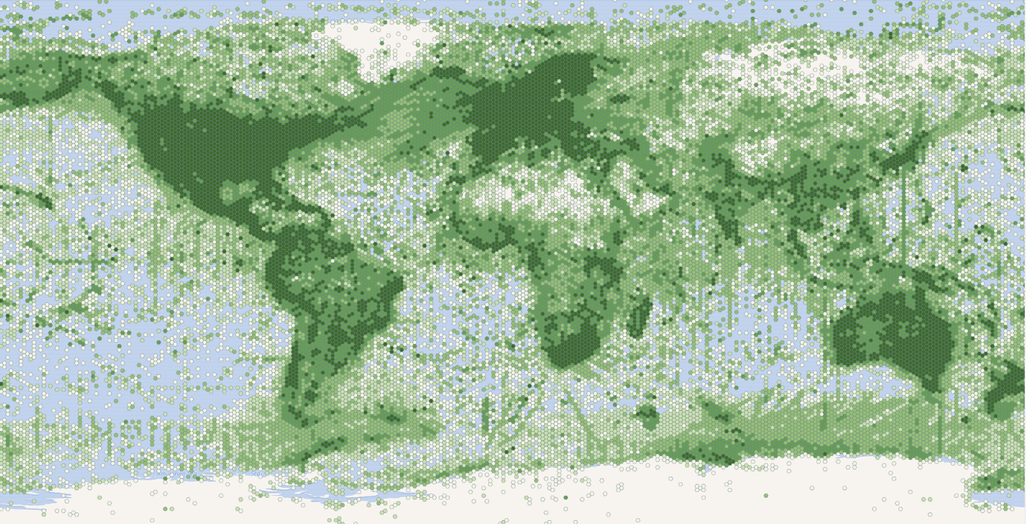

GBIF offers a variation of different maps – that illustrates the spatial coverage bias
Notes:
GBIF offers a variation of different maps – that illustrates the spatial coverage bias, and gaps.

Slide 8
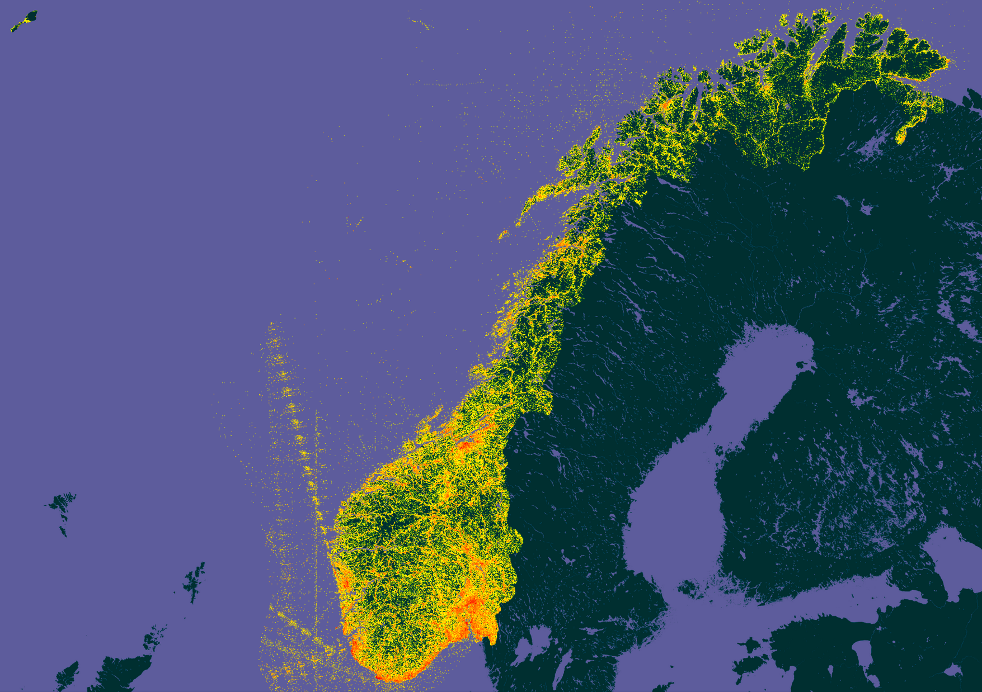

Data bias: Unequal sampling in time and space.
Botanist effect: Sampling density is higher near urban areas with universities.
Notes:
Data set published about Norway (localities in Norway): 19,315,896 total records. GBIF Data Portal, Norway, http://www.gbif.org/country/NO/about Updated 2015-11-11.
--

Slide 9
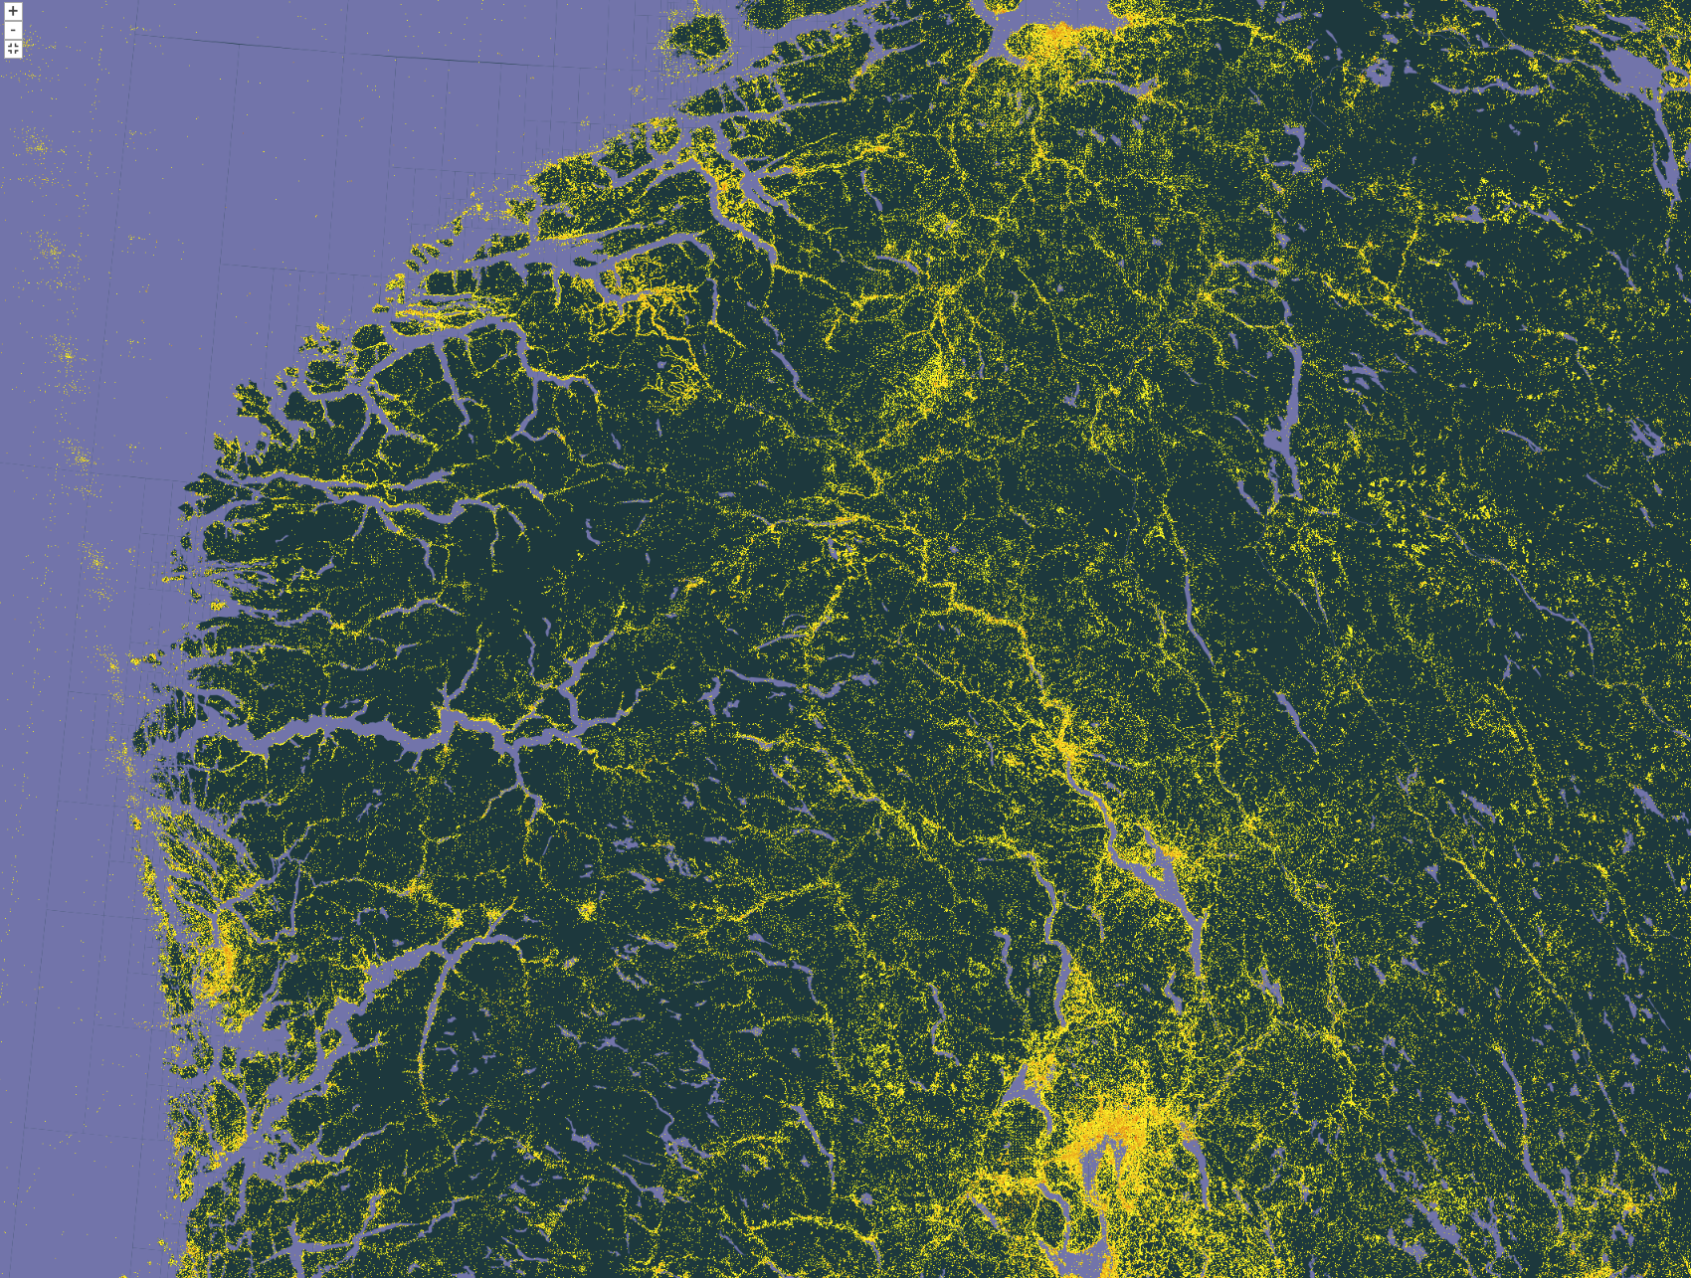
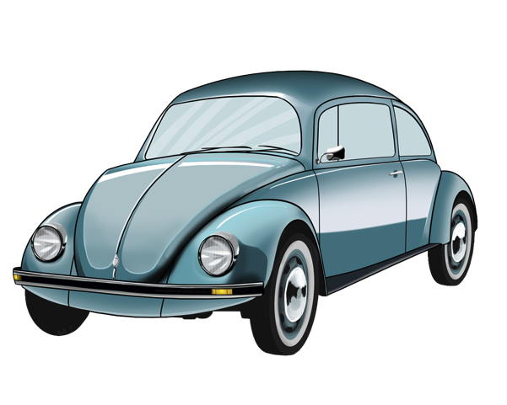
Data bias: Unequal sampling in time and space.
Road effect: Sampling density is higher near roads (along the valleys) and areas accessible by naturalists.

Slide 10
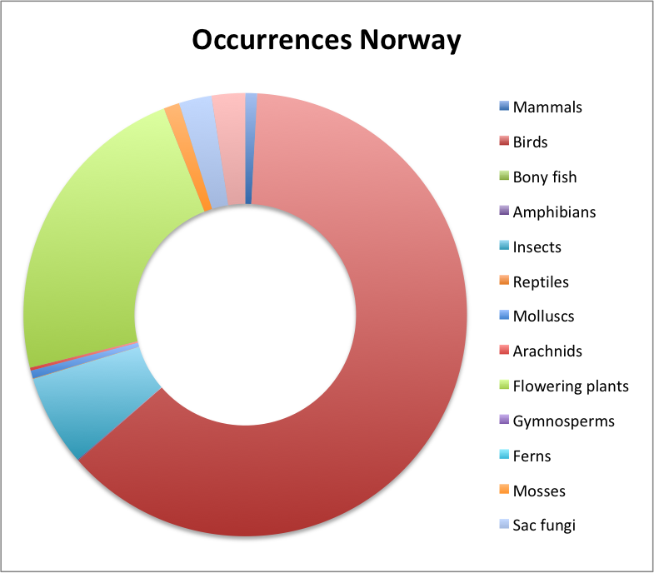
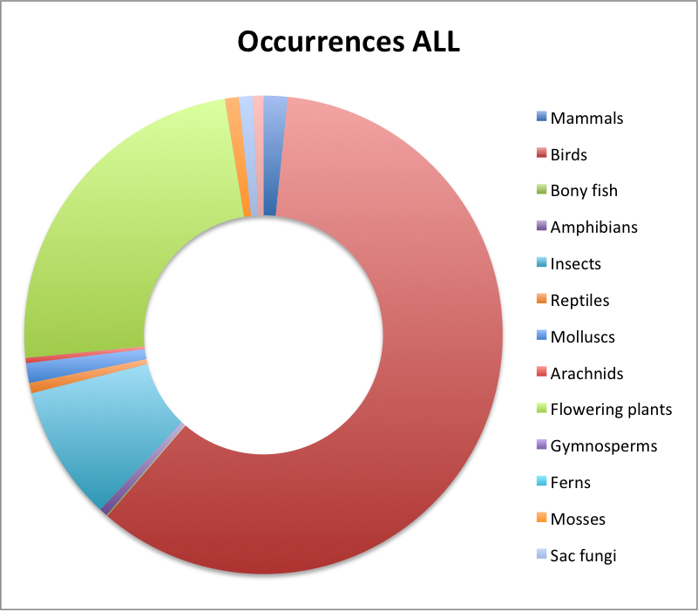






Bias: Disproportionate representation of taxa.
Flowering plants (23 %)
5 248 418
occurrences
Birds (60 %)
483 005 906
occurrences
Flowering plants (24 %)
193 813 553
occurrences
Birds (63 %)
14 393 261
occurrences
Insects (7 %)
1 530 914
occurrences
Insects (9 %)
73 725 958
occurrences
Notes:
Rank Taxon Taxon group Occurrences_NO PCT Occurrences_NO PCT Occurrences_ALL PCT class Mammalia Mammals 189 012 1% 199 503 0,9% 13 190 892 1,6% https://www.gbif.org/occurrence/search?country=NO&taxon_key=359 class Aves Birds 13 940 540 63% 14 393 261 62,7% 483 005 906 59,7% https://www.gbif.org/occurrence/search?country=NO&taxon_key=212 superclass Osteichthyes Bony fish 196 219 1% 1 371 0,0% 613 505 0,1% https://www.gbif.org/occurrence/search?q=Osteichthyes&country=NO class Amphibia Amphibians 15 650 0% 16 109 0,1% 4 552 766 0,6% https://www.gbif.org/occurrence/search?country=NO&taxon_key=131 class Insecta Insects 1 616 316 7% 1 530 914 6,7% 73 725 958 9,1% https://www.gbif.org/occurrence/search?country=NO&taxon_key=216 class Reptilia Reptiles 7 671 0% 7 853 0,0% 5 622 982 0,7% https://www.gbif.org/occurrence/search?country=NO&taxon_key=358 phylum Mollusca Molluscs 139 001 1% 132 758 0,6% 10 791 354 1,3% https://www.gbif.org/occurrence/search?country=NO&taxon_key=52 class Arachnida Arachnids 50 022 0% 50 698 0,2% 2 914 334 0,4% https://www.gbif.org/occurrence/search?country=NO&taxon_key=367 phylum Tracheophyta Flowering plants 4 450 373 20% 5 248 418 22,9% 193 813 553 23,9% https://www.gbif.org/occurrence/search?country=NO&taxon_key=7707728 superclass Gymnospermae Gymnosperms 67 522 0% 1 573 0,0% 103 933 0,0% phylum Pteridophyta Ferns 287 546 1% 25 0,0% 3 139 0,0% https://www.gbif.org/occurrence/search?country=NO&taxon_key=59 phylum Bryophyta Mosses 273 548 1% 265 868 1,2% 7 589 102 0,9% https://www.gbif.org/occurrence/search?country=NO&taxon_key=35 phylum Ascomycota Sac fungi 533 046 2% 546 879 2,4% 7 575 854 0,9% https://www.gbif.org/occurrence/search?country=NO&taxon_key=95 phylum Basidiomycota Basidiomycota 533 375 2% 560 185 2,4% 5 746 856 0,7% https://www.gbif.org/occurrence/search?country=NO&taxon_key=34

Slide 11

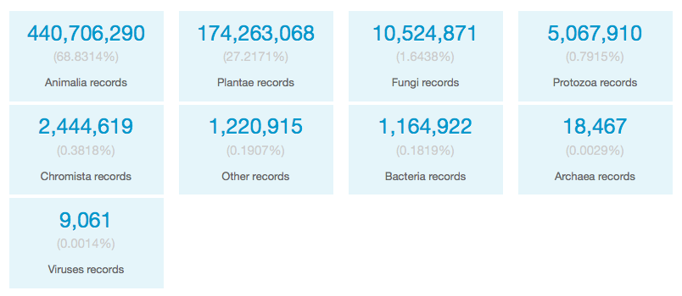

Data bias: Disproportionate representation of taxa.
Bird-watcher effect: Data for animals and in particular birds are "overrepresented" in GBIF.
Numbers last updated 2015
Notes:
https://www.gbif.org/tools/observation-trends/about
https://www.gbif.org/tools/observation-trends
https://www.gbif.org/analytics/global
https://www.gbif.org/news/82367/gbiforg-adds-data-trends-charts-and-richer-national-information

Slide 12
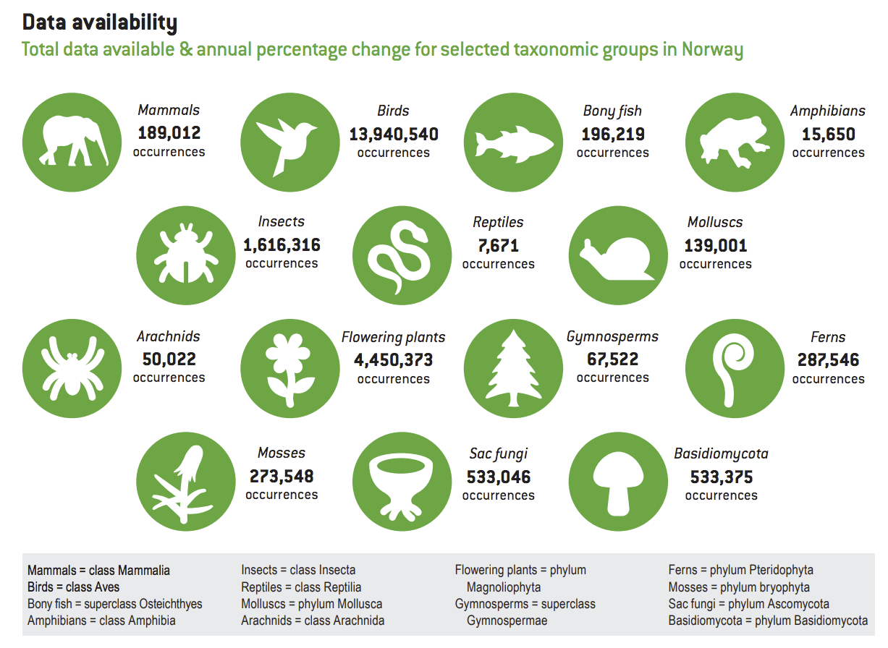
0,8 %
63 %
0,9 %
0,1 %
7 %
0,07 %
0,6 %
0,2 %
20 %
0,3 %
1,3 %
1,2 %
2,4 %
2,4 %
Notes:
https://www.gbif.org/tools/observation-trends/about
https://www.gbif.org/tools/observation-trends
https://www.gbif.org/analytics/global
https://www.gbif.org/news/82367/gbiforg-adds-data-trends-charts-and-richer-national-information

Slide 13

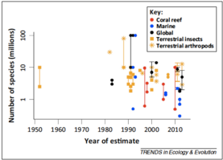
Data bias: taxa described with names
The Catalogue of Life is a quality-assured checklist of more than 1.6 million species known to science.
Total ≈ 8.7 millions species? (excluding bacteria and micro-organisms)
Mora C, Tittensor DP, Adl S, Simpson AGB, Worm B (2011) How Many Species Are There on Earth and in the Ocean? PLoS Biology 9(8): e1001127. doi:10.1371/journal.pbio.1001127
Caley J, Fisher R, and Mengersen K (2014) Global species richness have not converged. Trends in Ecology and evolution 29(4): 187-188. doi:10.1016/j.tree.2014.02.002
Caley et al. 2014
Notes:
How many species?
http://www.catalogueoflife.org/
Mora C, Tittensor DP, Adl S, Simpson AGB, Worm B (2011) How Many Species Are There on Earth and in the Ocean? PLoS Biol 9(8): e1001127. doi:10.1371/journal.pbio.1001127
Giller G (2014 April 8th) Are we any closer to knowing how many species there are on earth? Scientific American, http://www.scientificamerican.com/article/are-we-any-closer-to-knowing-how-many-species-there-are-on-earth/
Caley J, Fisher R, and Mengersen K (2014) Global species richness have not converged. Trends in Ecology and evolution 29(4): 187-188. doi:10.1016/j.tree.2014.02.002

Slide 14
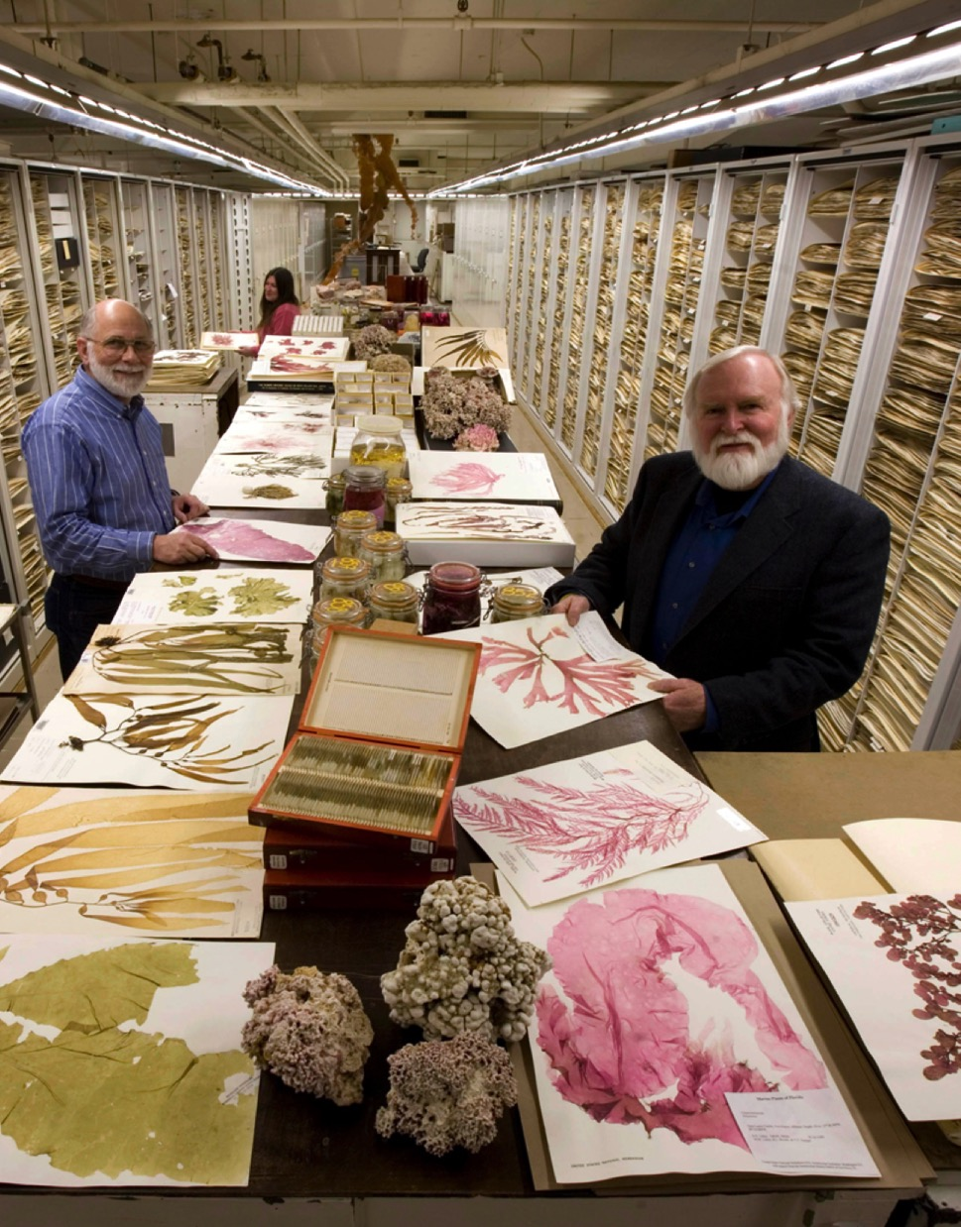
Data bias: few specimens digitized
The total number of specimens in natural history collections worldwide is estimated to 1.2 to 3 billion.
(Ariño 2010; Duckworth et al. 1993)
GBIF indexes 876 million records – including 128 million specimens
=> 4% to 10% coverage?
Photo: Botany Collection, Algae, Smithsonian National Museum of Natural History Museum, by Chip Clark.
Notes:
* Ariño A. (2010). Approaches to estimating the universe of natural history collections data. Biodiversity Informatics, 7:81–92. [Estimate 1.2 to 2.1 billion museum specimens]
* Duckworth, W.D., Genoways, H.H. and Rose, C.L. (1993). Preserving Natural Science Collections: Chronicle of our Environment Heritage. Washington, DC: National Institute for the Conservation of Cultural Property 140 pp. [Estimate 2-3 billion museum specimens]
* Smith VS and Blagoderov V (2012). Bringing collections out of the dark. ZooKeys 209: 1-6. DOI: 10.3897/zookeys.209.3699
* Scoble MJ (2010). Natural History collections digitization: Rationale and value. Biodiversity Informatics, 7: 77-80.
* Berendsohn W., Chavan V., Macklin J.A. (2010). GBIF task group on the global strategy and action plan for the mobilization of NHM collections data. Biodiversity Informatics, 7:67-71.
Photo: Botany Collection, Algae, Smithsonian National Museum of Natural History Museum, by Chip Clark.

Slide 15


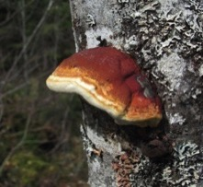

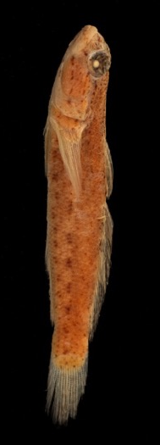
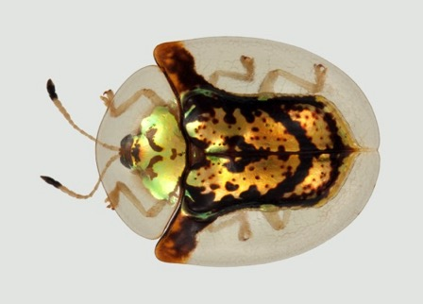
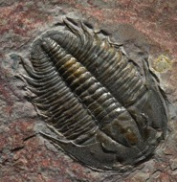
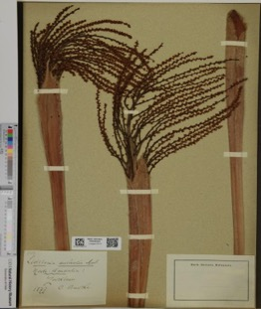


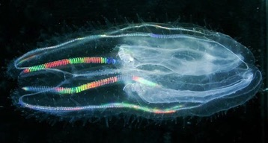
Digitized specimens (UiO NHM Oslo)
Fungi: 640 000
Vertebrates: 670 000
Insects: 3,4 million
Paleontology:
900 000
Vascular plants:
2,2 million
Invertebrates: 600 000
Photos by Karsten Sund (UiO NHM); Slide by Eirik Rindal, 2014 (UiO NHM)
Notes:
Slide originally presented by Eirik Rindal, NHM-UiO on 2014-04-01 national meeting for the natural history university museums.
http://www.nhm.uio.no/forskning/publikasjoner/rapporter/NHM-rapport-18-samlingsplan.pdf
Fungi: 640 000, Insects: 3,4 mill, Vertebrates: 670 000, Paleontology: 900 000, Vascular plants: 2,2 mill, Invertebrates: 600 000

Slide 16
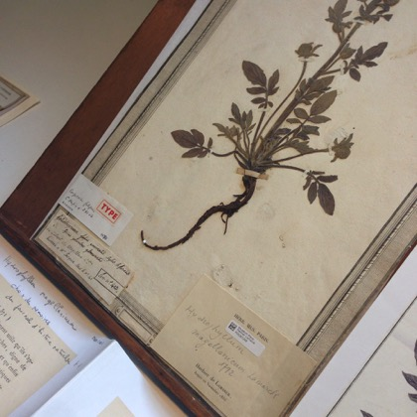
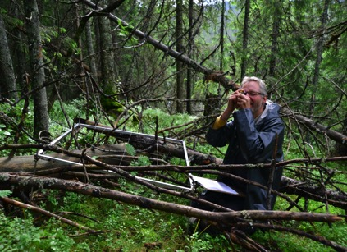
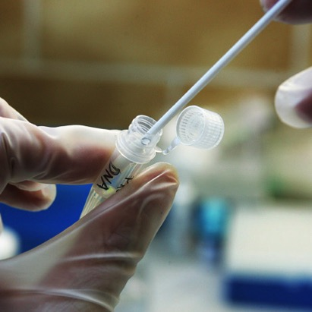
Different types of "evidence" data
Darwin Core occurrence data provide different types of evidence for the occurrence of a species in time and space.
Museum specimens
Naturalist species observations
Species or ecosystem monitoring data
Molecular DNA samples
….
Paris Herbarium, CC-BY Dag Endresen
Image credit: Anders Bryn
Notes:
Professor Rune Halvorsen (NHM-UiO) making vegetation plot observations at Solhomfjell in Telemark, summer of 2013. Credit: Anders Bryn, NHM-UiO, Skog og Landskap.

Slide 17
Data quality & fitness for use

Slide 18

Data fitness depends on data being
accessible
timely
easy to read
relevant
consistent
complete
specific
comprehensive
The true value of biodiversity data can be measured by the extent to which it is used.
Notes:
Redman, T.C. 2001. Data Quality: The Field Guide. Boston, MA: Digital Press. ISBN:1-55558-251-6
The value of biodiversity data can be measured by the extent to which it is used.
Making data as fit as possible for as many uses as possible has potential benefits.

Slide 19
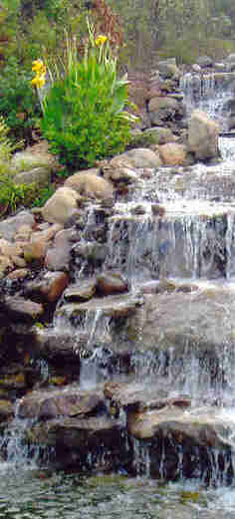
Improving fitness-for-use
Aggregate
Progressive improvement
Data indexes
Centralized discovery
Standardization of persistent identifiers
Consistent metadata
Data quality
Inconsistencies within records
Validation against metadata
Outlier detection
Metrics per record and per data set
Expert curation
Interface with taxon expert groups
Incorporate findings of data users
Need efficient researcher-friendly tools
Data Indexes
Data Quality
Expert Curation
Slide by Donald Hobern, 2012
Notes:
A focus on one of the data pathway components. Data aggregation should be a multi-stage process, including simple improvement in data accessibility (already achieved), automated processing to detect problems, enhance quality and enrich descriptive metadata (well under way) and expert intervention to refine data and address problems that cannot be handled automatically. This last stage (expert curation) is a major challenge for GBIF as for other biodiversity informatics projects and should probably be handled as a joint concern for all these programmes – particularly since the expert community is so small. This will mean that the biodiversity informatics community will need to focus on delivery of easily-used tools to support such curation, with clear immediate benefits to researchers if they use these tools.

Slide 20
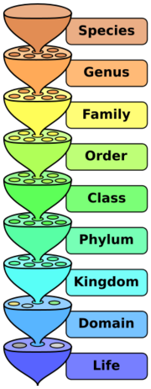
Taxonomic data
Names are often the first point of entry to biodiversity databases.
=> Risk of error propagation.
Possible errors:
Wrong identification
Wrong format
Spelling errors
Slide by Laura Russell, VertNet, September 2011
Notes:
We generally think about scientific names, but we shouldn't forgot common names.
Point of entry => means if we have an error here, all returned data is invalid (propagation of errors).
Wrong identifications will need the help of a taxonomist to be solved.
For others, we can mitigate the problems with IT solutions or cleaning and validation techniques

Slide 21
Taxonomic data
Error checking:
Missing values
Incorrect values
Non-atomic values
Domain schizophrenia
Duplicates
Inconsistent data
Slide by Laura Russell, VertNet, September 2011
Notes:
Missing values: i.e., subspecies without species
Incorrect values: check for transposition of key strokes, values in wrong column, '??' values, phonetic values, ...
Non-atomic values: for example, 'subsp. bicostasa' in one single field
Domain schizophrenia: species: 'globulus?' => uncertainty is in the species column.
Duplicates: several names refer to the same real-world concept (misspellings, synonyms errors, several valid names,...)
Inconsistent data: Occurs when merging two databases using different lists.

Slide 22

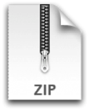


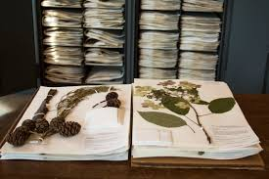


Example of data cleaning workflow
Source
DwC-Archive
day: 18
Data cleaning
month: 5
verbatimEventDate:
18 Mayo 2016
year: 2016
startDayOfYear: 139
endDayOfYear: 139
eventDate: 2016-05-18

Slide 23
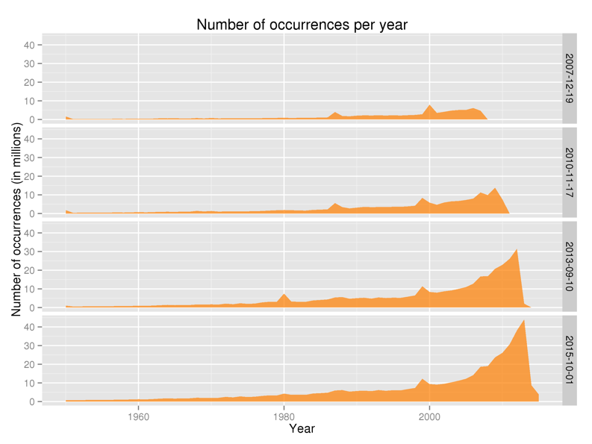
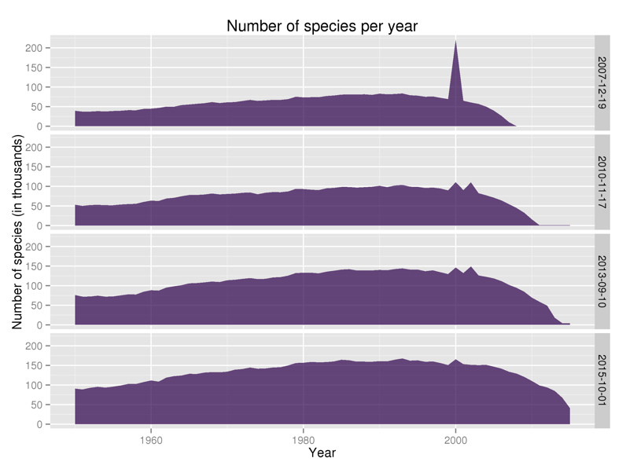
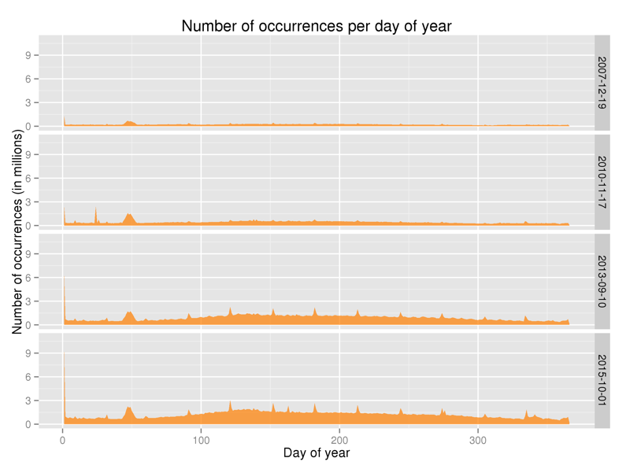
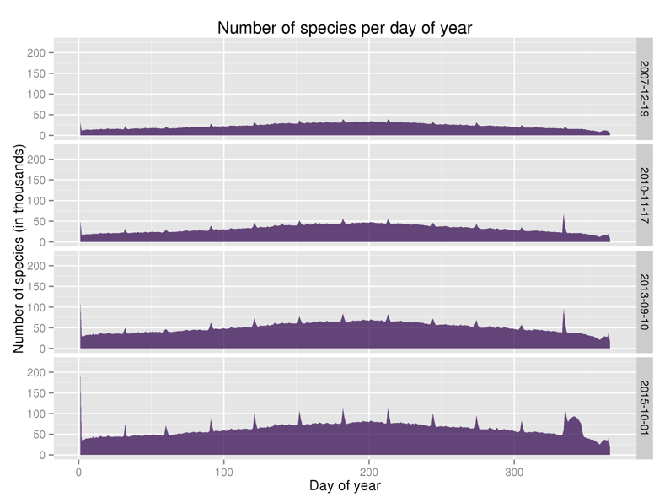
Temporal dimension: year, time, seasonality …
Notes:
Temporal dimension: year, time, seasonality …
http://www.gbif.org/analytics/global

Slide 24
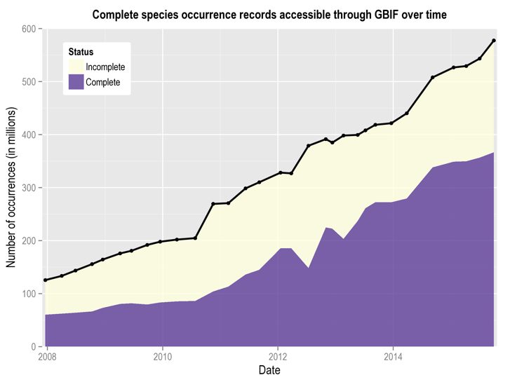
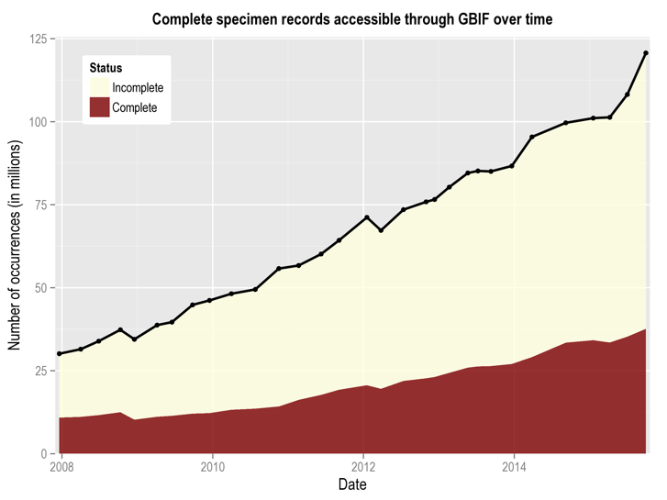
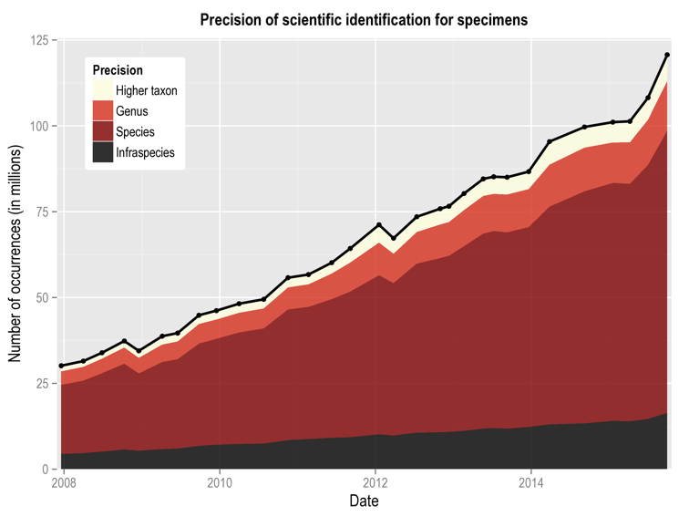
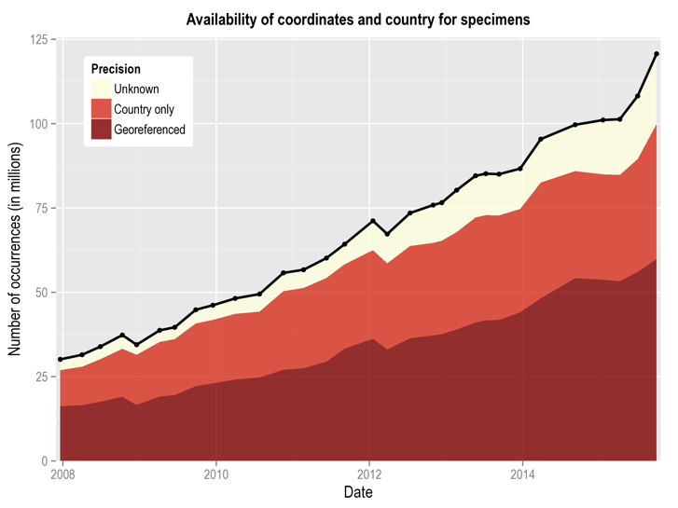
Completeness & precision
A record is here defined to be complete if it includes an identification at least to species rank, valid coordinates, a full date of occurrence and a given basis of record (e.g. observation, specimen).
Notes:
http://www.gbif.org/analytics/global

Slide 25
Data validation tools

Slide 26
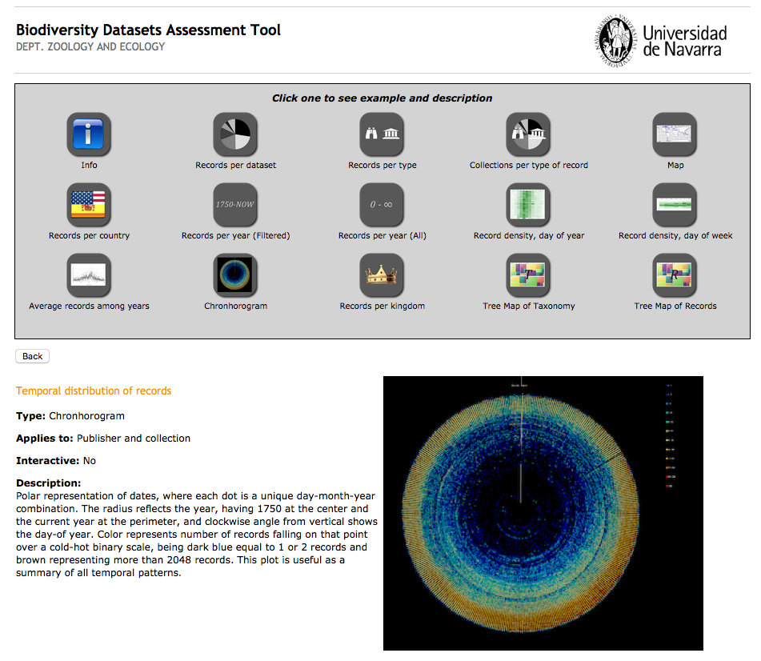
BIDSAT
This online tool allows to analyze datasets published and registered in the GBIF network. You can select any dataset and extract metrics based on different variables (taxonomy, type of record, etc.) and also automatically produce maps and other diagrams.
Otegui, J. (2012) Biodiversity Datasets Assessment Tool (BIDDSAT). Universidad de Navarra. Available online at http://www.unav.es/unzyec/mzna/biddsat/
Notes:
Otegui, J. (2012) Biodiversity Datasets Assessment Tool (BIDDSAT). Universidad de Navarra. Available online at http://www.unav.es/unzyec/mzna/biddsat/.
http://www.gbif.org/resource/81711

Slide 27
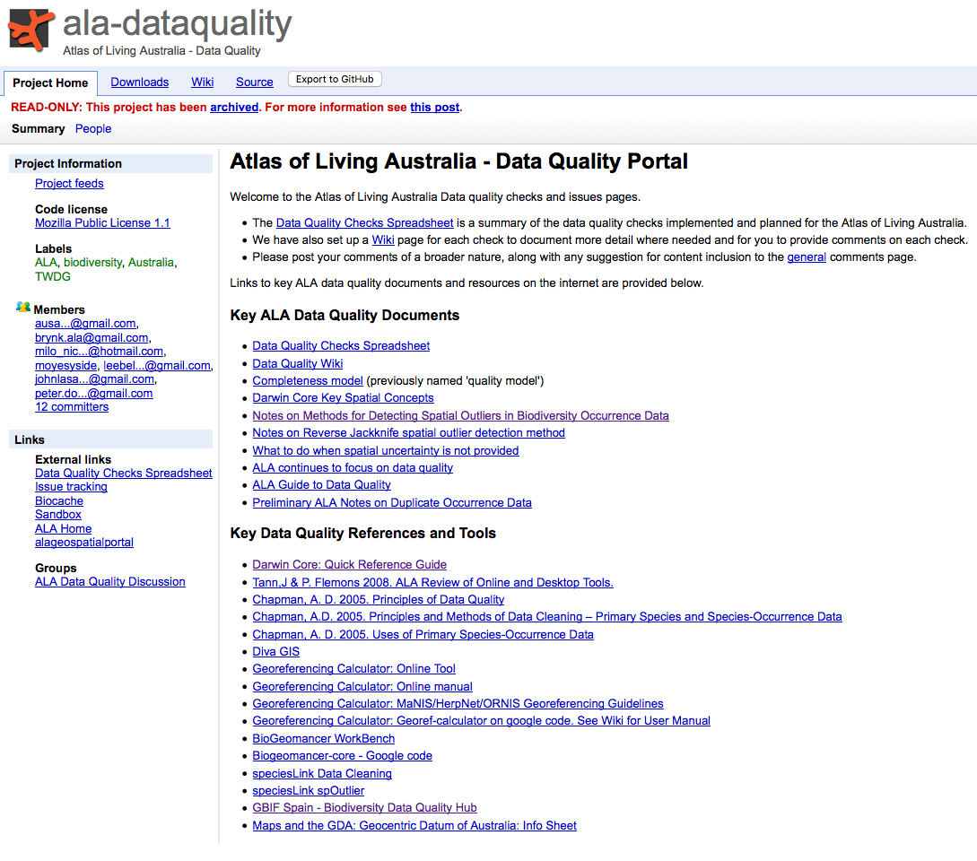

Atlas of Living Australia
Notes:
Atlas of Living Australia
https://code.google.com/p/ala-dataquality/

Slide 28
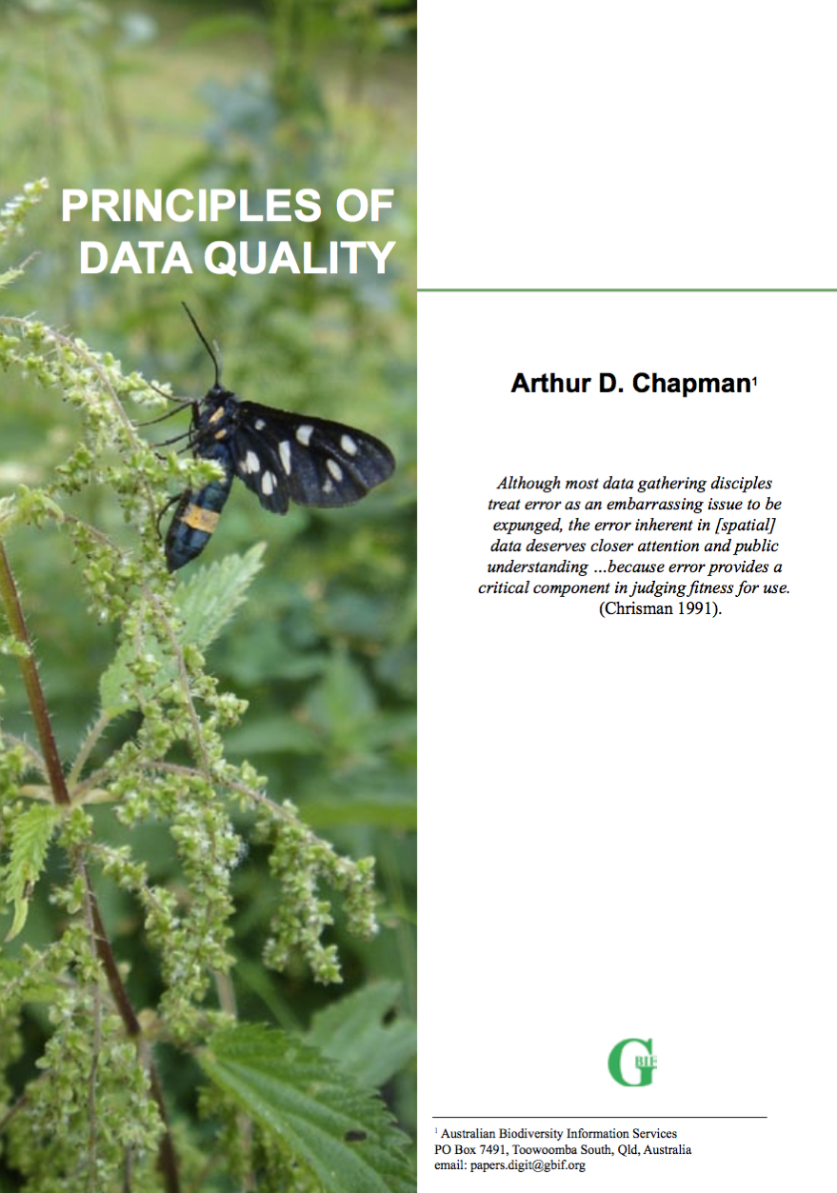
Chapman, A. D. (2005) Principles of Data Quality, version 1.0. Report for the Global Biodiversity Information Facility, Copenhagen. ISBN 87-92020-03-8.
Available online at http://www.gbif.org/resource/80509
http://www.gbif.org/orc/?doc_id=1229
Notes:
Chapman, A. D. 2005. Principles of Data Quality, version 1.0. Report for the Global Biodiversity Information Facility, Copenhagen. ISBN 87-92020-03-8.
Available online at http://www.gbif.org/orc/?doc_id=1229, http://www.gbif.org/resource/80509
Chapman A.D. “Principles of Data Quality” MS PowerPoint Presentation. Global Biodiversity Information Facility. September 21 2011. Accessible online at: http://www.gbif.org/orc/?doc_id=3135, http://www.gbif.org/resource/81791

Slide 29
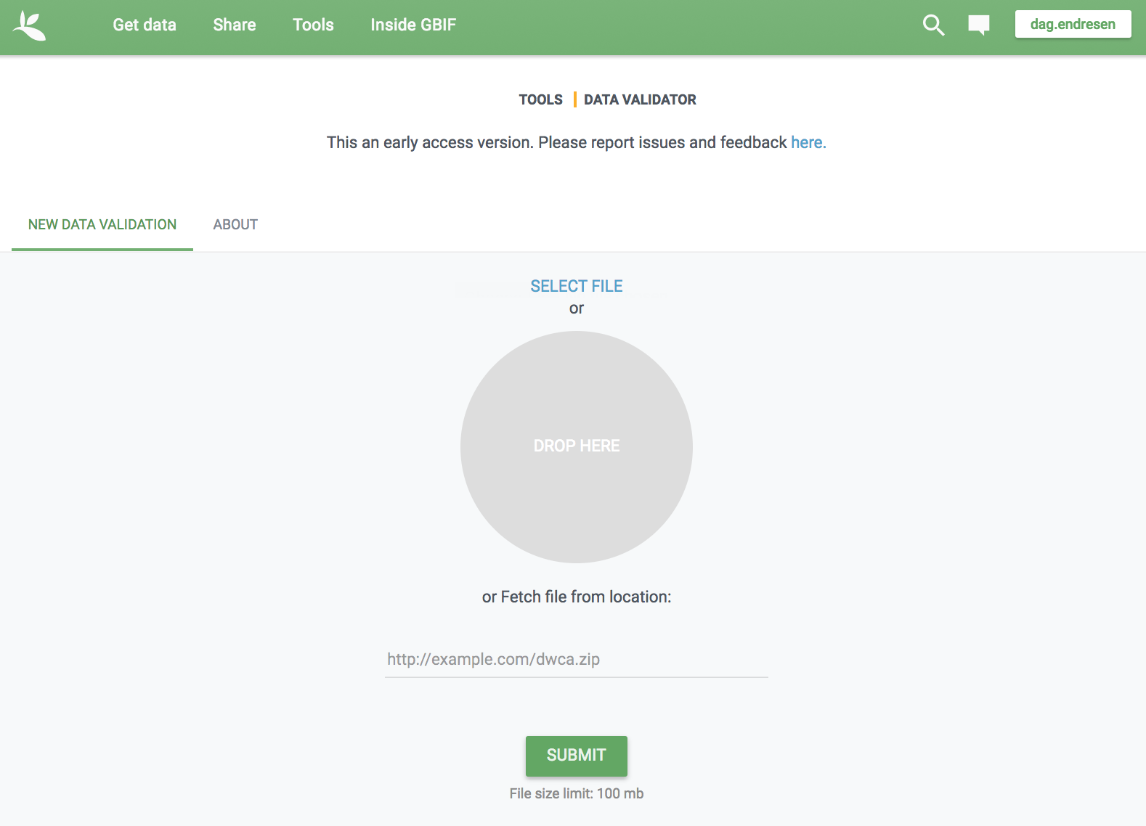
Released 2017-11-01:
https://www.gbif.org/tools/data-validator
Notes:
https://www.gbif.org/tools/data-validator
https://www.gbif.org/news/1typAByt7mWSuoAY6sM442/new-gbif-data-validator-provides-pre-publication-review-of-datasets
https://github.com/gbif/gbif-data-validator

Slide 30
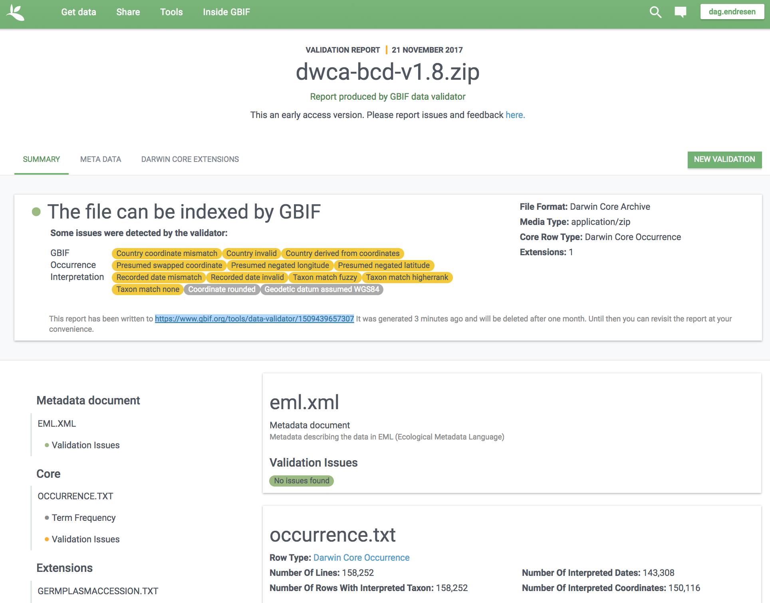
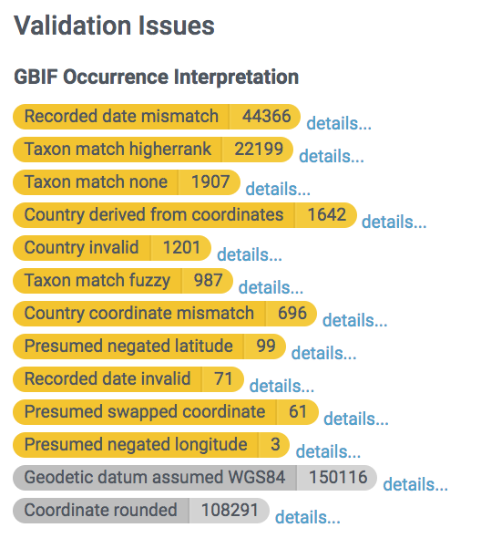
Notes:
https://www.gbif.org/tools/data-validator
https://www.gbif.org/news/1typAByt7mWSuoAY6sM442/new-gbif-data-validator-provides-pre-publication-review-of-datasets
https://www.gbif.org/tools/data-validator/1509439657307

Slide 31
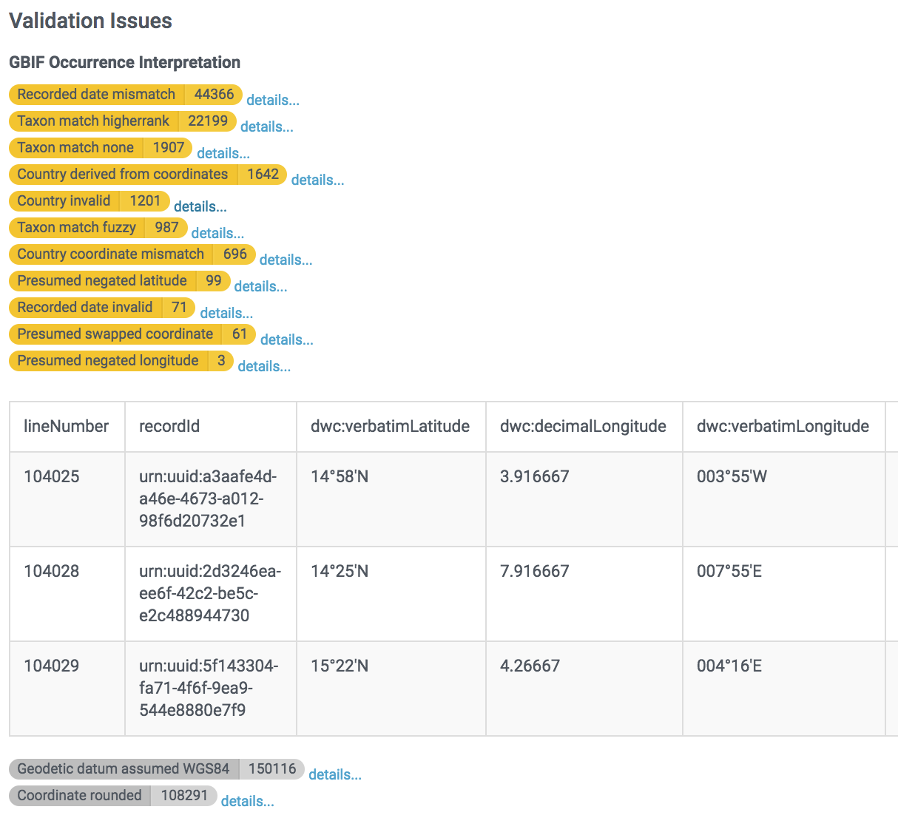
Notes:
https://www.gbif.org/tools/data-validator
https://www.gbif.org/news/1typAByt7mWSuoAY6sM442/new-gbif-data-validator-provides-pre-publication-review-of-datasets
https://www.gbif.org/tools/data-validator/1509439657307

Slide 32
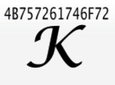
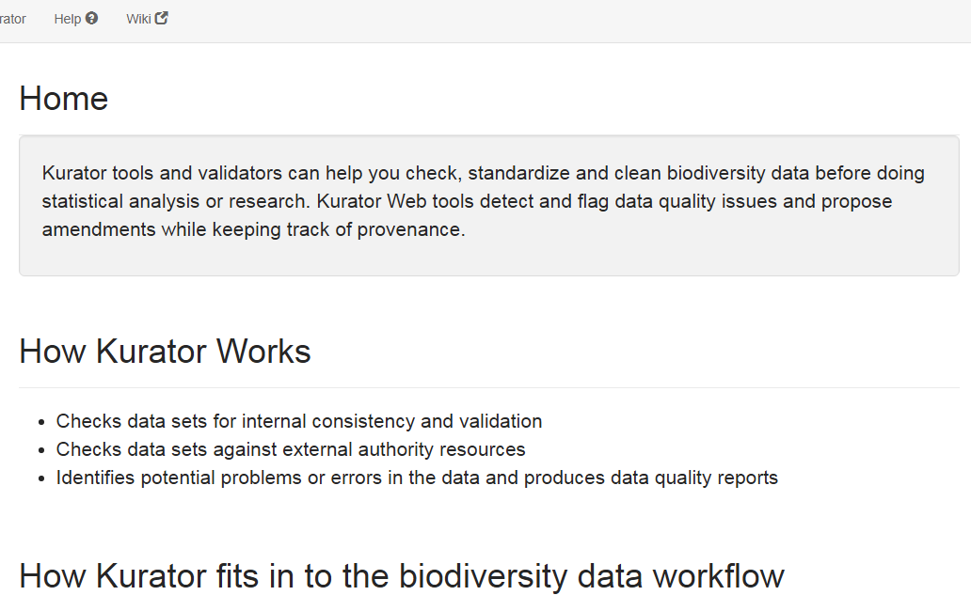

Kurator Web
Kurator Web
Kurator Web http://kurator.acis.ufl.edu/kurator-web/about

Slide 33








Kurator Web
Currently Available Workflows
Kurator Web

Slide 34

Data validation services at GBIF.no

Slide 35


Notes:
http://dev.gbif.no/datasets/d0aa984e-c6d3-45ee-8fc0-df1df8f4126b/p/report

Slide 36

Notes:
http://dev.gbif.no/datasets/d0aa984e-c6d3-45ee-8fc0-df1df8f4126b/p/occurrence/105140

Slide 37




August 1877
Skåne, Sweden
Dyntaxa (Sweden)
GBIF taxon backbone
Notes:
Dyntaxa (Sweden)

Slide 38



Improving georeferences
The fish collection at NHM had some of the longitude latitude values mixed up…
Noticed and corrected in April 2013.
GBIF dataset identifier:
doi:10.15468/4vqytb
Indexed in GBIF on 14 January 2013
Re-indexed in GBIF on 3 May 2013
Notes:
Data quality issue, 2013-04-25 (Fridtjof and Christian). The fish collection at NHM has some longitude latitude columns swapped… Noticed and corrected in April. (dataset 8102)
Fish collection at NHM-UiO. Inverted coordinates cause points for occurrences of fish in the sea outside Norway to be plotted accross the Indian sea and into the Himalayas.
GBIF dataset identifier: http://doi.org/10.15468/4vqytb
Access point URL:http://dev.gbif.no/ipt/resource?r=o_fish
Added to portal:Feb 11, 2009
Information updated: January 14, 2013
Information updated: May 3, 2013
MAP dataset 8102, Fish collection NHM-UiO (modified color and country borders)
http://ogc.gbif.org/wms?request=GetMap&bgcolor=0xBBCCEE&styles=,,&layers=gbif:country_fill,gbif:tabDensityLayer&srs=EPSG:4326&filter=()(<Filter><PropertyIsEqualTo><PropertyName>url</PropertyName><Literal><![CDATA[http%3A%2F%2Fdata.gbif.org%2Fmaplayer%2Fresource%2F8102]]></Literal></PropertyIsEqualTo></Filter>)()&width=721&height=362&Format=image/png&bbox=-180,-90,180,90
MAP dataset 8102, Fish collection NHM-UiO (cut to northern and eastern hemisphere)
http://ogc.gbif.org/wms?request=GetMap&bgcolor=0xBBCCEE&styles=,,&layers=gbif:country_fill,gbif:tabDensityLayer&srs=EPSG:4326&filter=()(<Filter><PropertyIsEqualTo><PropertyName>url</PropertyName><Literal><![CDATA[http%3A%2F%2Fdata.gbif.org%2Fmaplayer%2Fresource%2F8102]]></Literal></PropertyIsEqualTo></Filter>)()&width=721&height=362&Format=image/png&bbox=0,0,180,90

Slide 39
Community
peer-review

Slide 40


Published to GBIF
Notes:
http://www.inaturalist.org/
http://www.inaturalist.org/observations/dagendresen
http://www.gbif.org/dataset/50c9509d-22c7-4a22-a47d-8c48425ef4a7
http://www.gbif.org/occurrence/1024229755

Slide 41

Annotating biodiversity data
Tschöpe et al. (2013) Annotating biodiversity data via the Internet.
Notes:
Tschöpe, O., Macklin, J. A., Morris, R. A., Suhrbier, L., & Berendsohn, W. G. (2013, December 20). Annotating biodiversity data via the Internet. Taxon. International Association for Plant Taxonomy (IAPT). doi:10.12705/626.4
Morris RA, Dou L, Hanken J, Kelly M, Lowery DB, Ludäscher B, et al. (2013) Semantic Annotation of Mutable Data. PLoS ONE 8(11): e76093. doi:10.1371/journal.pone.0076093
Rod Page (2014) iPhylo: Rethinking annotating biodiversity data, http://iphylo.blogspot.no/2014/03/rethinking-annotating-biodiversity-data.html
http://iphylo.blogspot.no/2014_03_01_archive.html
Walls RL, Deck J, Guralnick R, Baskauf S, Beaman R, Blum S, et al. (2014) Semantics in Support of Biodiversity Knowledge Discovery: An Introduction to the Biological Collections Ontology and Related Ontologies. PLoS ONE 9(3): e89606. doi:10.1371/journal.pone.0089606

Slide 42

BIG DATA
A new paradigm:
reuse of research data

Slide 43


"Machine learning algorithms have successfully identified plant species in massive herbaria just by looking at the dried specimens. According to researchers, similar AI approaches could also be used identify the likes of fly larvae and plant fossils"
Researchers trained... algorithms on more than 260,000 scans of herbarium sheets, encompassing more than 1,000 species. The computer program eventually identified species with nearly 80% accuracy: the correct answer was within the algorithms’ top 5 picks 90% of the time. That, says (Penn State paleobotanist Peter) Wilf, probably out-performs a human taxonomist by quite a bit.
Carranza-Rojas J, Goeau H, Bonnet P, Mata-Montero E, and Joly A (2017) Going deeper in the automated identification of Herbarium specimens. BMC Evolutionary Biology 17:181. https://doi.org/10.1186/s12862-017-1014-z
Ledford H (2017) Artificial intelligence identifies plant species for science: Deep-learning methods successfully classify thousands of herbarium samples. Nature News 11 August 2017. doi:10.1038/nature.2017.22442
Carranza-Rojas J, Joly A, Bonnet P, Goëau H, Mata-Montero E (2017) Automated Herbarium Specimen Identification using Deep Learning. Proceedings of TDWG 1: e20302. https://doi.org/10.3897/tdwgproceedings.1.20302
Notes:
Carranza-Rojas J, Joly A, Bonnet P, Goëau H, Mata-Montero E (2017) Automated Herbarium Specimen Identification using Deep Learning. Proceedings of TDWG 1: e20302. https://doi.org/10.3897/tdwgproceedings.1.20302
https://biss.pensoft.net/article/20302/list/9/
Carranza-Rojas J, Goeau H, Bonnet P, Mata-Montero E, and Joly A (2017) Going deeper in the automated identification of Herbarium specimens. BMC Evolutionary Biology 17:181. https://doi.org/10.1186/s12862-017-1014-z
https://bmcevolbiol.biomedcentral.com/articles/10.1186/s12862-017-1014-z
Ledford H (2017) Artificial intelligence identifies plant species for science: Deep-learning methods successfully classify thousands of herbarium samples. Nature News 11 August 2017. doi:10.1038/nature.2017.22442
http://www.nature.com/news/artificial-intelligence-identifies-plant-species-for-science-1.22442
Unger J, Merhof D, and Renner S (2016) Computer vision applied to herbarium specimens of German trees: testing the future utility of the millions of herbarium specimen images for automated identification. BMC Evolutionary Biology 16:248. https://doi.org/10.1186/s12862-016-0827-5
https://boingboing.net/2017/08/11/artificial-intelligence-identi.html
https://techcrunch.com/2017/08/11/deep-learning-could-discover-new-plant-species-hidden-in-centuries-of-herbarium-data/
Page LM, MacFadden BJ, Fortes JA, Soltis PS, and Riccardi G (2015) Digitization of Biodiversity Collections Reveals Biggest Data on Biodiversity. BioScience 65(9): 841–842, https://doi.org/10.1093/biosci/biv104

Slide 44















From publications to GBIF as an automated service
GBIF
GBIF Taxonomic Backbone
2017 text and data mining output:
132 journals, 44 published in 2017
8,545 / 2,288 articles
69,539 / 18,565 taxonomic treatments
6,387 / 3,604 new species
45,381 / 39,759 observation records
56,692 / 12,250 figures
267,728 / 87,855 bibliographic references
Building the catalogue of life by machine…
Slide by Donat Agosti, Plazi.org October 2017
Notes:
Donat Agosti :: Plazi
agosti@plazi.org; @myrmoteras
ORCID: 0000-0001-9286-1200
DOI: 10.5281/zenodo.997213
September 26, 2017. GBIF GB24, Helsinki
----
Data mining activity for articles published in 2016
Number of articles mined 3,223 (20,578 total)
Number of journals covered 74 (609)
Number of pages 61,826 (445,764)
Number of figures 16,420 (114,008)
Number of bibliographic references 133,457 (992,388)
Number of treatments 43,767 (200,630)
Number of n.sp. 5,095 (40,934*)
* An estimated 30% of the annually new described species.
32,543 taxonomic names that are otherwise not in GBIF

Slide 45


The future has arrived
The future is already here — it's just not very evenly distributed
William Gibson
Notes:
The future is already here — it's just not very evenly distributed (William Gibson)
https://quoteinvestigator.com/2012/01/24/future-has-arrived/

